Slide 1
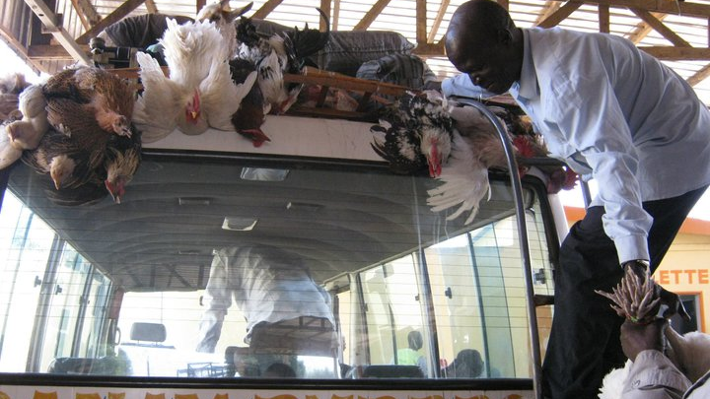
Data Science Final Project
Andrea Kornfeld
November 2018

Slide 2

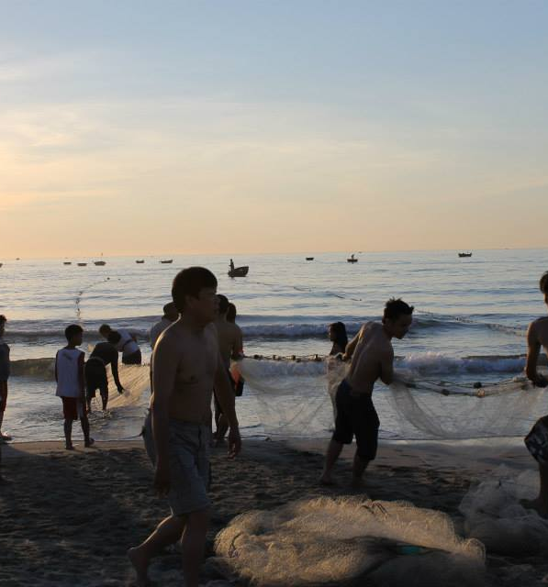
Background:
Kiva is a non-profit that allows people to lend money via the Internet to low-income entrepreneurs and students in over 80 countries.
Hypothesis:
Can we predict how many days it will take for a loan to get funded on Kiva?

Slide 3

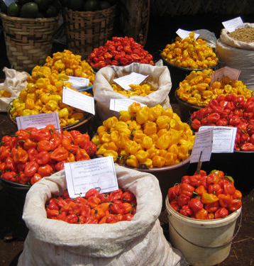
Data in the Models
The model is using a sample set of 1000 loans.
Featured Columns:
Loan amount
Repayment terms (in months)
Sector (Agriculture, Arts, Clothing, Construction, Education, Food, Health, Housing, Manufacturing, Personal Use, Retail, Services, Transportation, Wholesale)
Country (36 countries)
Looking to predict the number of days to fund a loan.
mean 8 days 06:07:07.472000
Std 11 days 08:05:18.560925
min 0 days 00:43:32
max 116 days 12:42:43
Data is from Kaggle: https://www.kaggle.com/kiva/data-science-for-good-kiva-crowdfunding#loan_themes_by_region.csv

Slide 4

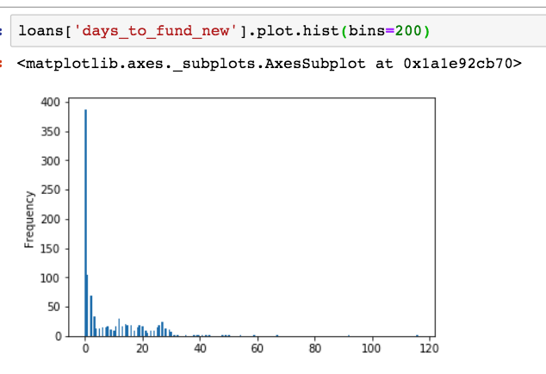
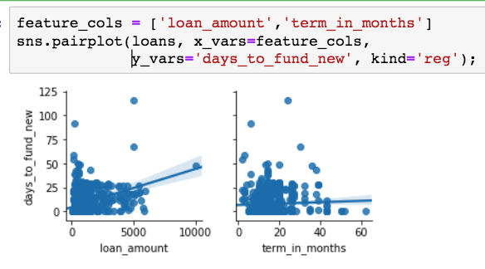
Visualizations (Matplotlib and Seaborn)

Slide 5
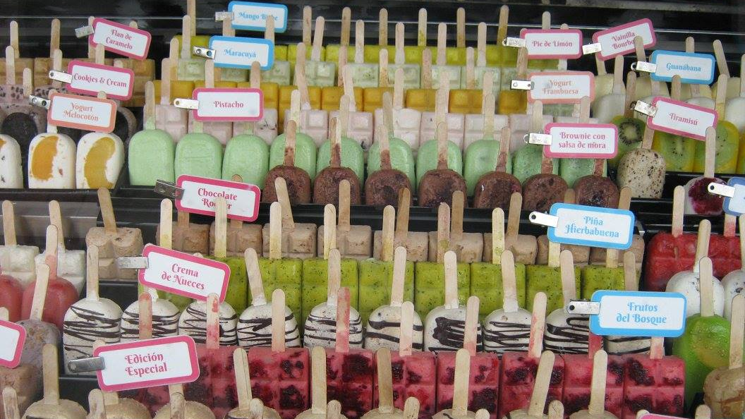
Models
Models | Featured Columns | Mean Squared Error
Linear Regression | Loan Amount | 11.14 days
Linear Regression | Loan Amount, Repayment terms | 11.15 days
Linear Regression | Loan Amount, Repayment terms, Sector | 10.92 days
Linear Regression | Loan Amount, Repayment terms, Country | 9.75 days
Linear Regression | Loan Amount, Sector, Country | 9.72 days
Standard Scaler with KNeighborsRegressors | Loan Amount, Sector, Country | 12.45 days
Standard Scaler with KNeighborsRegressors using Pipeline | Loan Amount, Sector, Country | 9.77 days
Randomized Search CV | Loan Amount, Sector, Country, Repayment terms | 7.32 days

